Slide 1


Georgi Naumov
22/07/2024

Slide 2

Outline
Executive Summary
Introduction
Methodology
Results
Conclusion
Appendix

Slide 3
Executive Summary
Summary of methodologies
Data collection
Data wrangling
Exploratory Data Analysis with Data Visualization
Exploratory Data Analysis with SQL
Building an interactive map with Folium
Building a Dashboard with Plotly Dash
Predictive analysis
Summary of all results
Exploratory Data Analysis results
Interactive analytics demo in screenshots
Predictive analysis results

Slide 4
Introduction
Project background and context
SpaceX is a leading company that makes space travel more affordable. They offer Falcon 9 rocket launches at a competitive price of $62 million, which is significantly cheaper than other providers who charge upwards of $165 million per launch. One reason for this cost savings is that SpaceX is able to reuse the first stage of their rockets. By analyzing whether the first stage will land, we can estimate the overall cost of a launch. To make this prediction, we'll use publicly available data and machine learning models.
Answers to problems we need to find
How the variables in the collected data affect the rocket launch result?
What is the trend of rocket launch results?
What algorithm to use for classification?

Slide 5

Section 1

Slide 6
Methodology
Executive Summary
Data collection methodology:
By using Space X REST API
By scraping Wikipedia
Perform data wrangling
The data was filtered and cleaned up
Missing values were replaced
Perform exploratory data analysis (EDA) using visualization and SQL
Perform interactive visual analytics using Folium and Plotly Dash
Perform predictive analysis using classification models
Classification models were build, tuned, evaluated

Slide 7
Data Collection
Data was collected from 2 separate source, in order to achieve completeness:
From the Space X REST API and from Wikipedia by web scraping.
Columns obtained from REST API: FlightNumber, Date, BoosterVersion, PayloadMass, Orbit, LaunchSite, Outcome, Flights, GridFins, Reused, Legs, LandingPad, Block, ReusedCount, Serial, Longitude, Latitude
Columns obtained from Wikipedia: Flight No., Launch site, Payload, PayloadMass, Orbit, Customer, Launch outcome, Version Booster, Booster landing, Date, Time

Slide 8
Data collection flowchart – Space X REST API
Request API data
Decode JSON data, as the API outputs in JSON. Then create dataframe using .json_normalize()
Use of provided functions to request more data
Constructing dictionaries from the obtained data
Export the data to a csv file
Missing values of payload mass were replaced by mean number
As we need data only for Falcon 9 engine, the rest was removed
Creation of a dataframe from the above data
https://github.com/geonaumov/IBM_Applied_data_science_capstone/blob/main/01%20Data%20collection%20API.ipynb

Slide 9
Data collection flowchart – Wikipedia
Pull data from Wikipedia
Extract column names using BeautifulSoup
Parse HTML tables using tags and collect the data
Export the data to a csv file
Create dataframe from dictionary
Construct a dictionary
https://github.com/geonaumov/IBM_Applied_data_science_capstone/blob/main/02%20Webscraping.ipynb

Slide 10
Data Wrangling
In order to proceed with the data analysis process, the data must be normalized. For all cases where the booster did not land successfully Below is an explanation of the relevant cases:
Sometimes a landing was attempted but failed due to an accident; for example, True Ocean means the mission outcome was successfully landed to a specific region of the ocean while False Ocean means the mission outcome was unsuccessfully landed to a specific region of the ocean. True RTLS means the mission outcome was successfully landed to a ground pad False RTLS means the mission outcome was unsuccessfully landed to a ground pad. True ASDS means the mission outcome was successfully landed on a drone ship False ASDS means the mission outcome was unsuccessfully landed on a drone ship.
We have to convert those outcomes into Training Labels with 1 means the booster successfully landed 0 means it was unsuccessful.
The following have to be calculated:
Number of launches per site
Orbit statistics
Mission outcome per orbit type
From the above, labels must be created
Export the data to csv file
https://github.com/geonaumov/IBM_Applied_data_science_capstone/blob/main/03%20Data%20wrangling.ipynb

Slide 11
EDA with Data Visualization
Chart were created in order to visualize and understand the data:
Flight Number vs. Payload Mass
Flight Number vs. Launch Site
Payload Mass vs. Launch Site
Orbit Type vs. Success Rate
Flight Number vs. Orbit Type
Payload Mass vs Orbit Type
Success Rate Yearly Trend
Scatter plots show the relationship between variables.
Bar charts show comparisons among discrete categories.
Line charts show trends in data over time (time series).
https://github.com/geonaumov/IBM_Applied_data_science_capstone/blob/main/05%20Visualization.ipynb

Slide 12
EDA with SQL
Displaying the names of the unique launch sites in the space mission
Displaying 5 records where launch sites begin with the string ‘CCA'
Displaying the total payload mass carried by boosters launched by NASA (CRS)
Displaying average payload mass carried by booster version F9 v1.1
Listing the date when the first successful landing outcome in ground pad was achieved
Listing the names of the boosters which have success in drone ship and have payload mass greater than 4000 but less than 6000
Listing the total number of successful and failure mission outcomes
Listing the names of the booster versions which have carried the maximum payload mass
Listing the failed landing outcomes in drone ship, their booster versions and launch site names for the months in year 2015
Ranking the count of landing outcomes (such as Failure (drone ship) or Success (ground pad)) between the date
2010-06-04 and 2017-03-20 in descending order
https://github.com/geonaumov/IBM_Applied_data_science_capstone/blob/main/04%20SQL.ipynb

Slide 13
Build an Interactive Map with Folium
Geographic Visualization of Launch Sites We've created markers to represent all launch sites, featuring:
The NASA Johnson Space Center, marked with a circle, popup label, and text label, using its latitude and longitude coordinates as a starting point.
Each launch site, marked with a circle, popup label, and text label, showcasing its geographical location and proximity to the Equator and coastlines.
Colored Markers for Launch Outcomes:
Successes are represented by green markers, while failures are shown in red.
Marker clustering helps identify launch sites with high success rates.
Distances between Launch Sites and Their Proximities:
We have added colored lines to illustrate the distances between launch site KSC LC-39A (used as an example) and its proximities, such as railways, highways, coastlines, and closest cities.
https://github.com/geonaumov/IBM_Applied_data_science_capstone/blob/main/06%20Folium.ipynb

Slide 14
Build a Dashboard with Plotly Dash
We have implemented several interactive features to enhance our visualization: A dropdown list allows users to select specific launch sites for further analysis.
A pie chart provides a breakdown of successful launches across all sites, as well as for individual sites when selected.
A slider enables users to filter payload mass ranges.
A scatter chart illustrates the correlation between payload mass and success rate for different booster versions.
https://github.com/geonaumov/IBM_Applied_data_science_capstone/blob/main/dashboard.py

Slide 15
Predictive Analysis (Classification)
Create a numpy array from “Class” column
Standarize data with StandatrdScaler
Fit and transform the data
Split the data into 2 sets: training and testing
Find the best parameters with GridSearchCV
Apply the results of GridSearchCV to LogReg, SVM, Decision tree and KNN models
Calculate the accuracy of the above
Examine the confusion matrix
Use Jaccard _score and F1_Score to find how the models performed
https://github.com/geonaumov/IBM_Applied_data_science_capstone/blob/main/08%20Machine%20learning.ipynb

Slide 16
Results
Exploratory data analysis results
Interactive analytics demo in screenshots
Predictive analysis results

Slide 17

Section 2

Slide 18
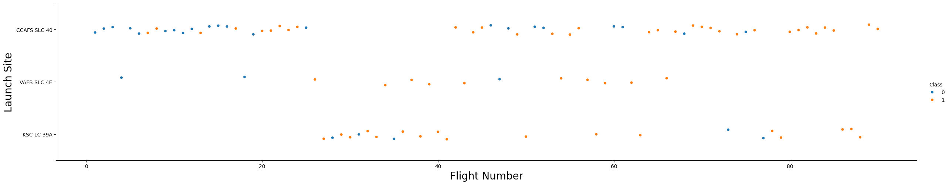
Flight Number vs. Launch Site
There is a positive trend of success
Most flights are from CCAFS SLC 40
The rest of the launch sites have higher success rate compared to CCAFS.

Slide 19
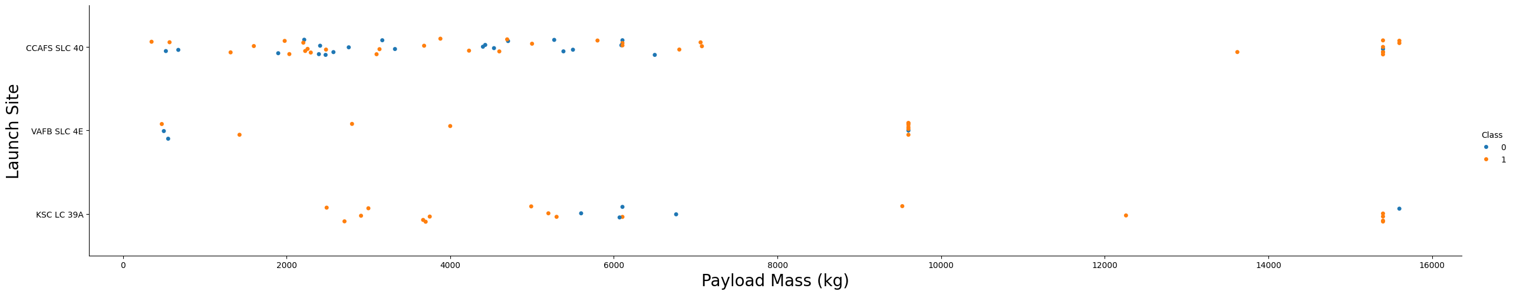
Payload vs. Launch Site
Large payloads have higher success rate, however this is probably due to correct risk management by Space X
Lower payload launches are probably experimental and have varying results

Slide 20
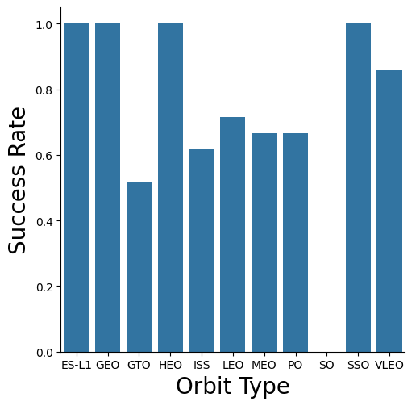
Success Rate vs. Orbit Type
Orbit types have varying results, however orbit SO has 0% success rate!

Slide 21
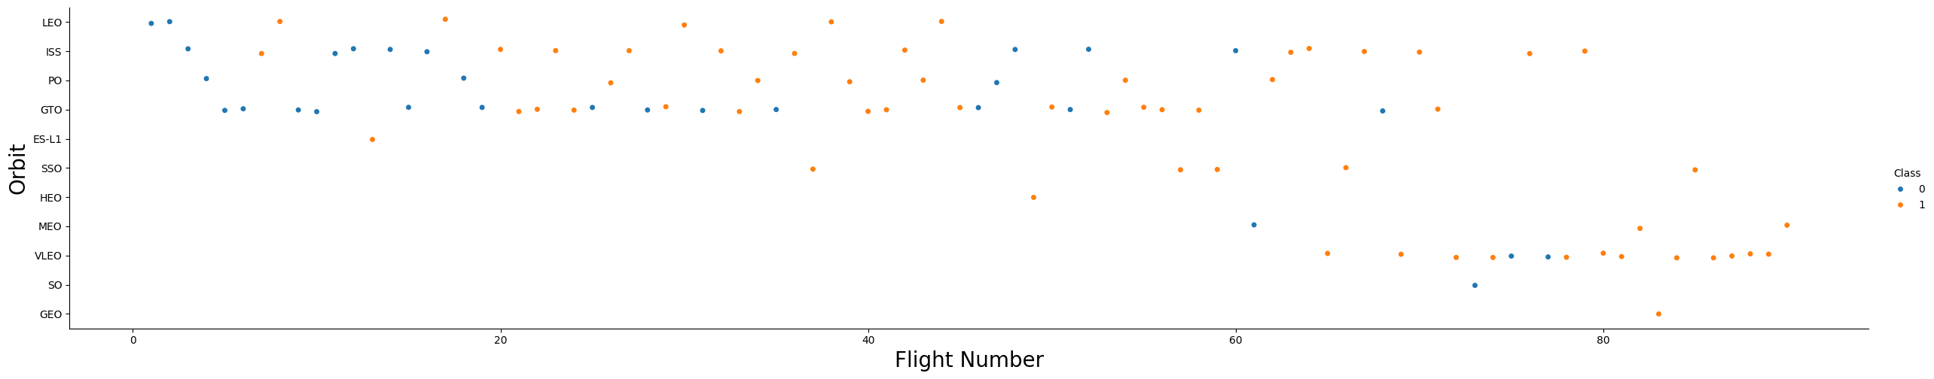
Flight Number vs. Orbit Type
LEO orbit has become successful as flight numbers increase
SO has one flight, so it’s zero success rate is not that bad
Newer sites are generally more successful as time passes.

Slide 22
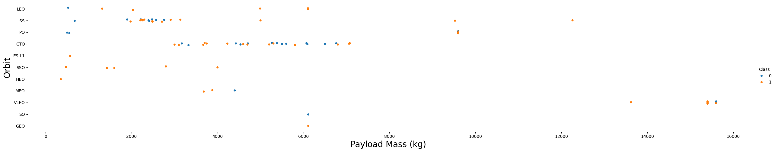
Payload vs. Orbit Type
ISS orbit is successful with high payloads
SSO is successful with low payloads

Slide 23
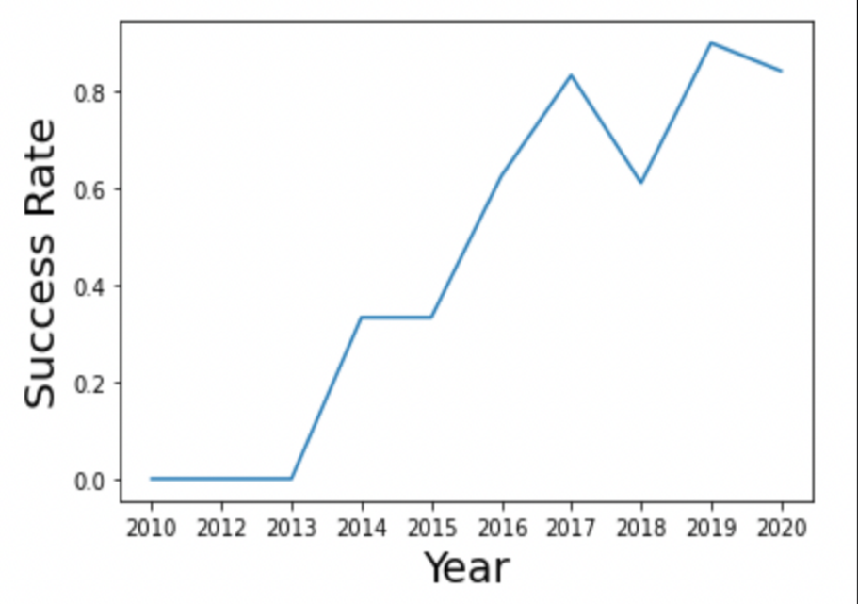
Launch Success Yearly Trend
Success rate is increasing up to 2020, with small fluctuation in 2018

Slide 24
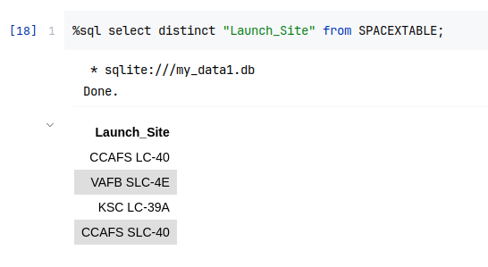
All Launch Site Names
SpaceX has 4 launch sites

Slide 25
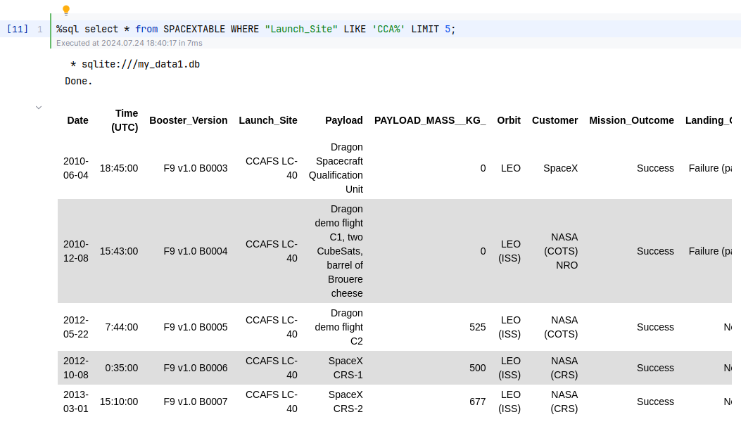
Launch Site Names Begin with 'CCA'

Slide 26
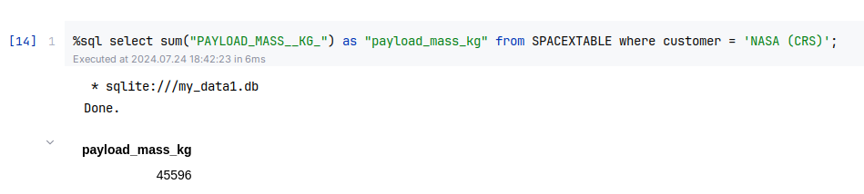
Total Payload Mass
Total payload mass in kilograms for client NASA (CRS)

Slide 27
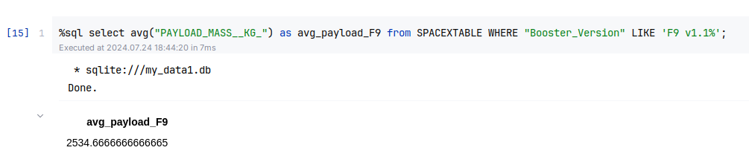
Average Payload Mass by F9 v1.1
Average payload mass in kilograms for booster F9 V1.1

Slide 28
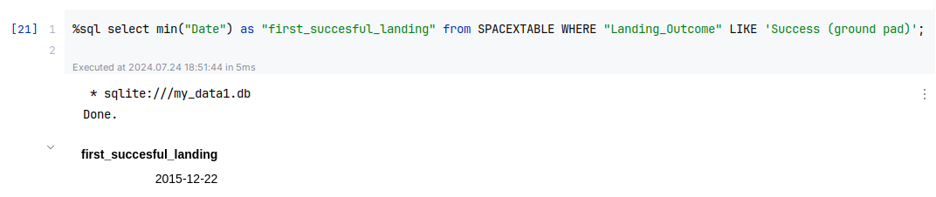
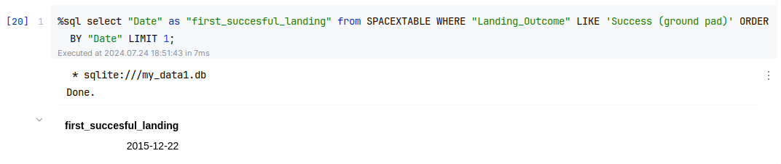
First Successful Ground Landing Date
OR

Slide 29
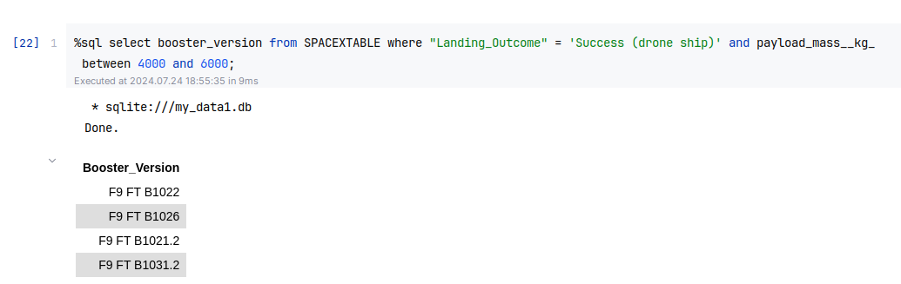
Successful Drone Ship Landing with Payload between 4000 and 6000

Slide 30
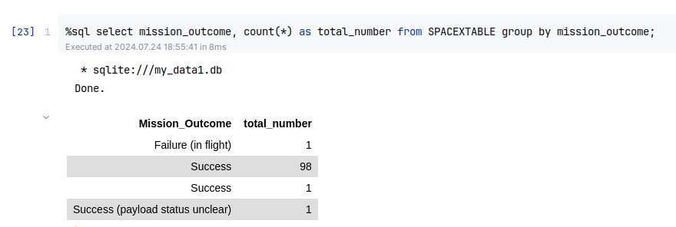
Total Number of Successful and Failure Mission Outcomes

Slide 31
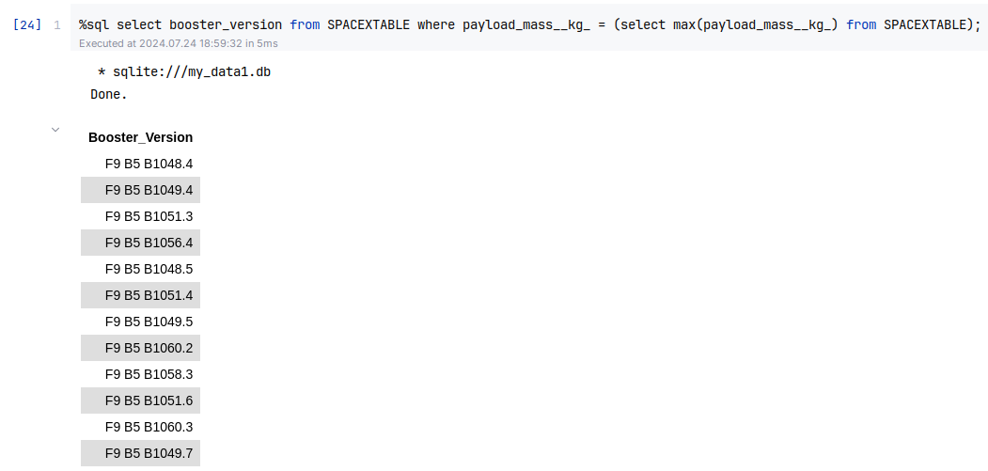
Boosters Carried Maximum Payload

Slide 32
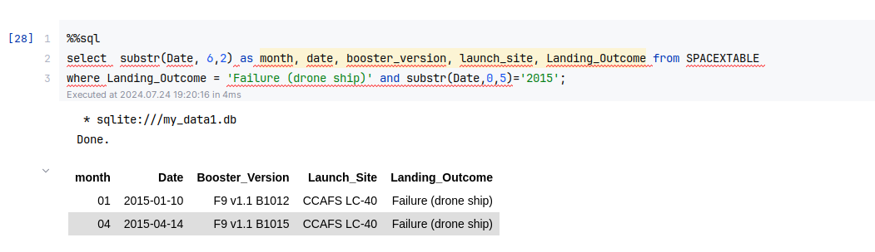
2015 Launch Records

Slide 33
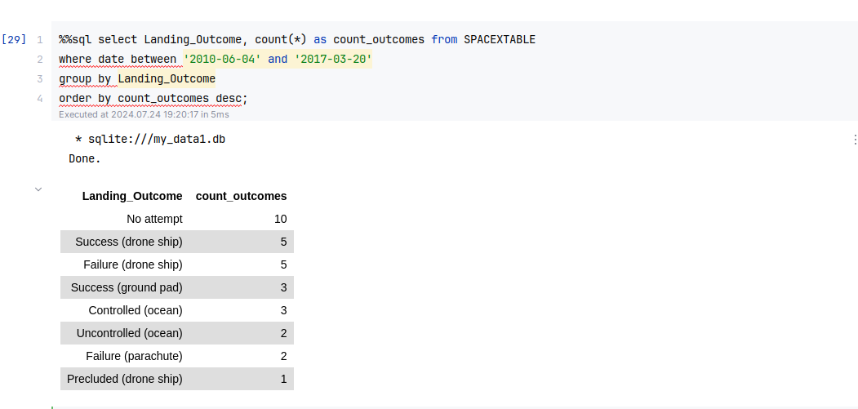
Rank Landing Outcomes Between 2010-06-04 and 2017-03-20

Slide 34

Section 3

Slide 35
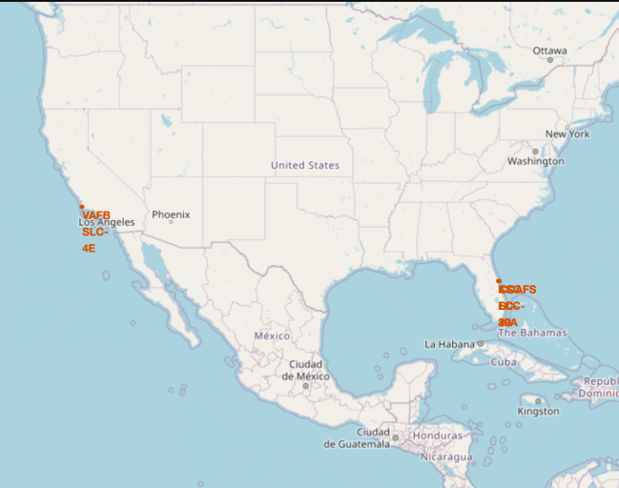
All launch sites on a map

Slide 36
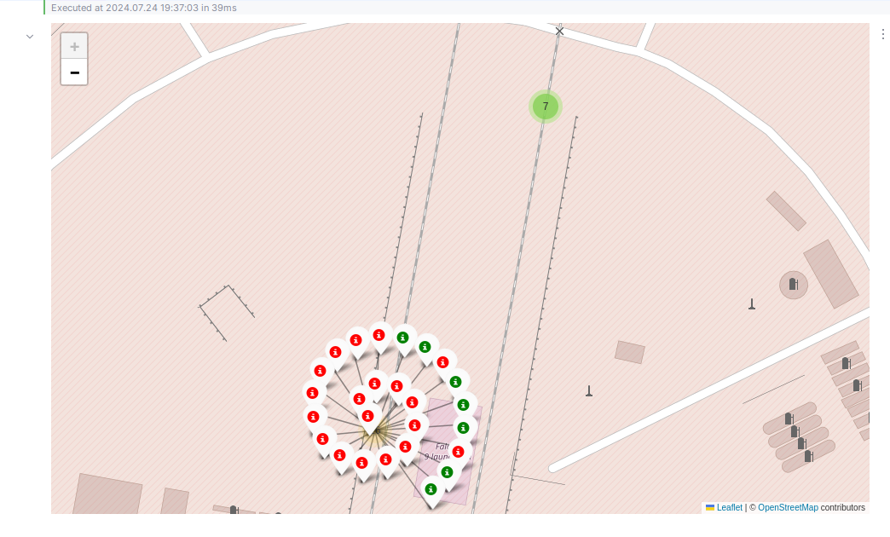
Colour-labeled launch markers on the map
Green markers represent successful launches
Red ones represent failed ones

Slide 37
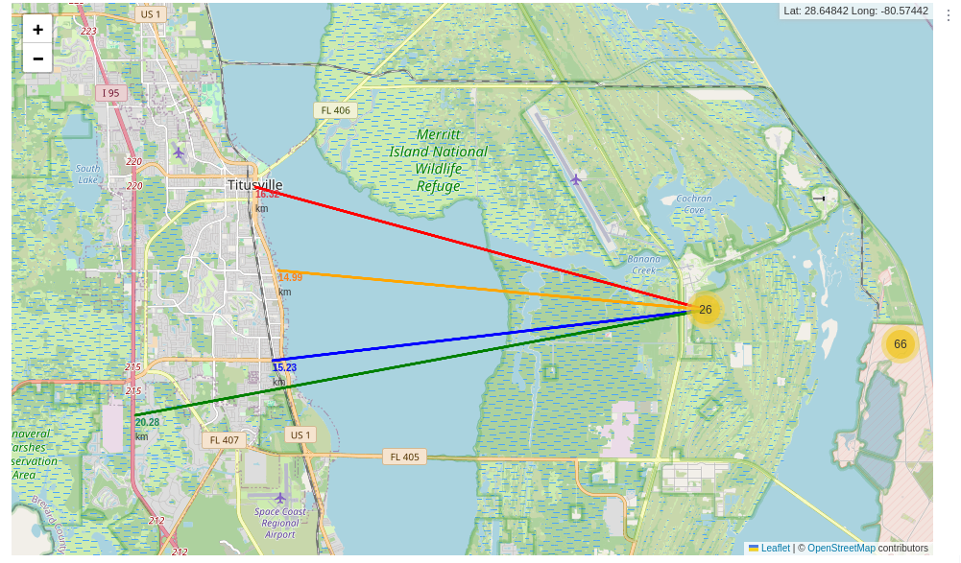
Proximities of launch site KSC LC-39A

Slide 38

Section 4

Slide 39
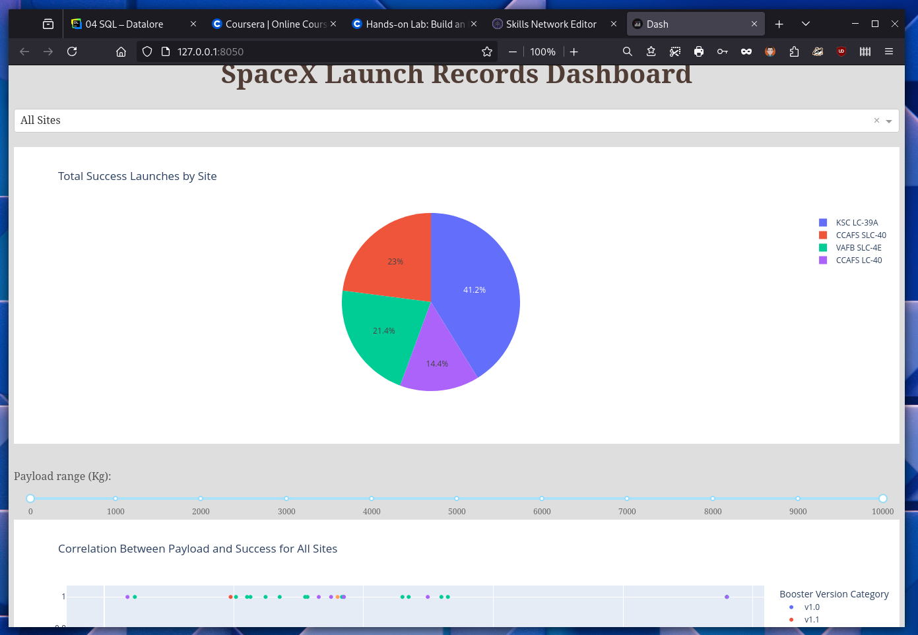
Launch success per launch site

Slide 40
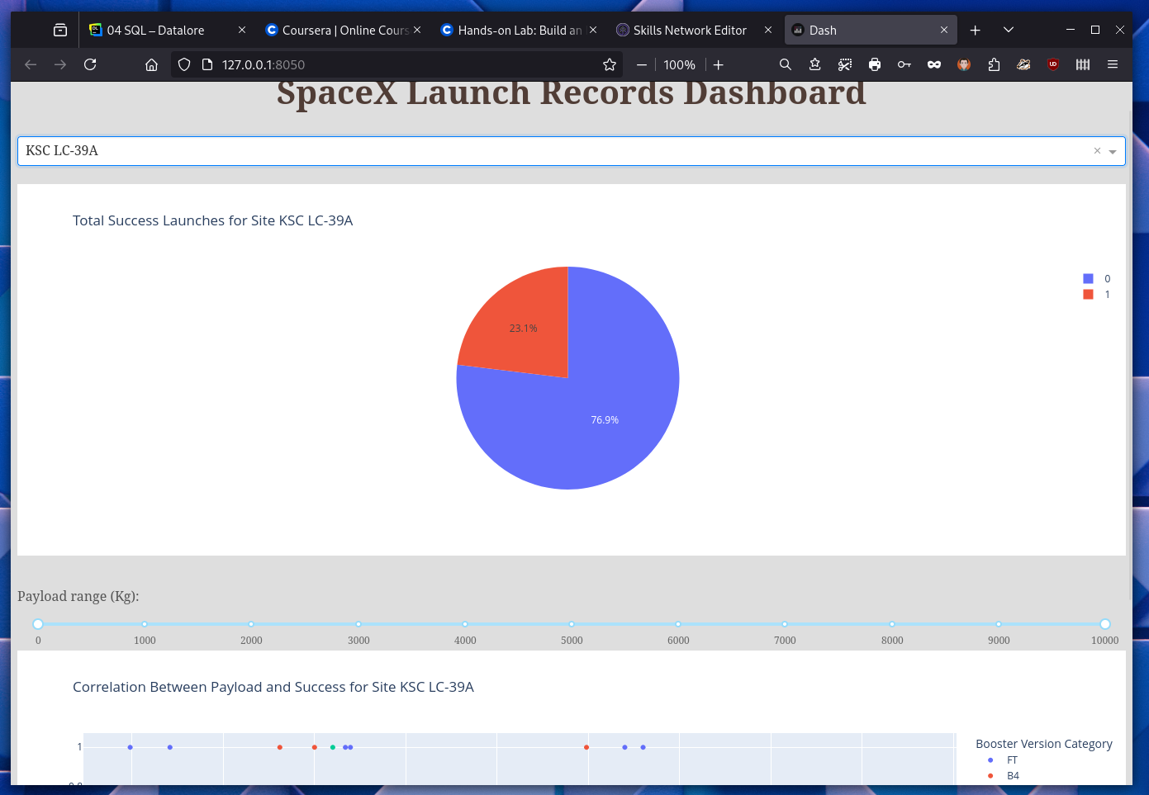
KSC LC-39A

Slide 41
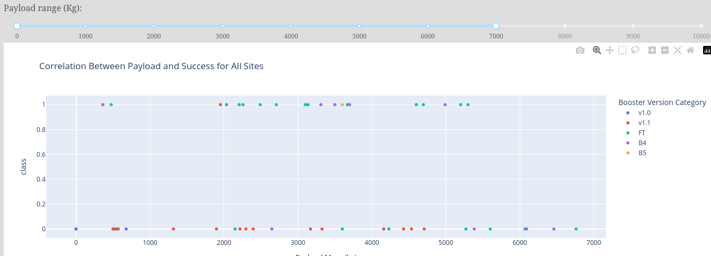
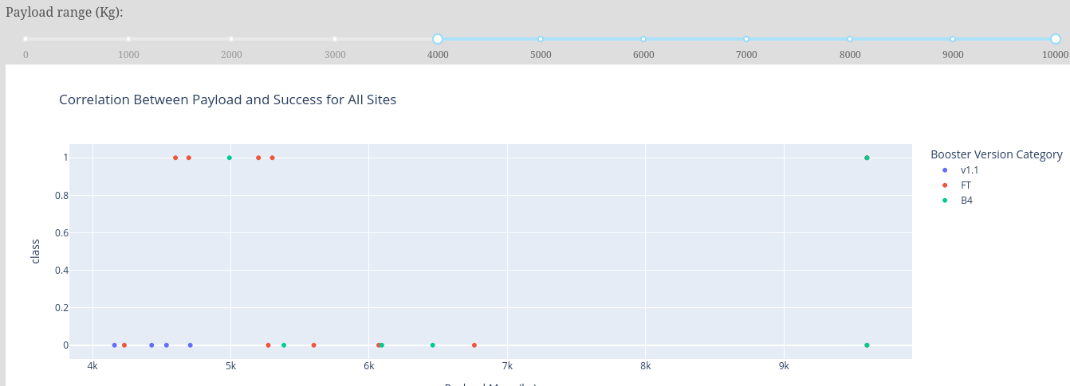
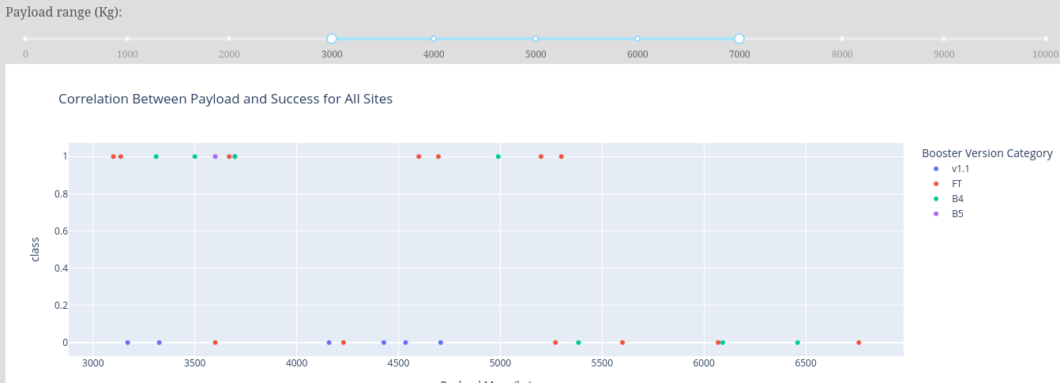
Payload mass success rate
Payloads between 5000 and 7000 kg are the most successful

Slide 42

Section 5

Slide 43
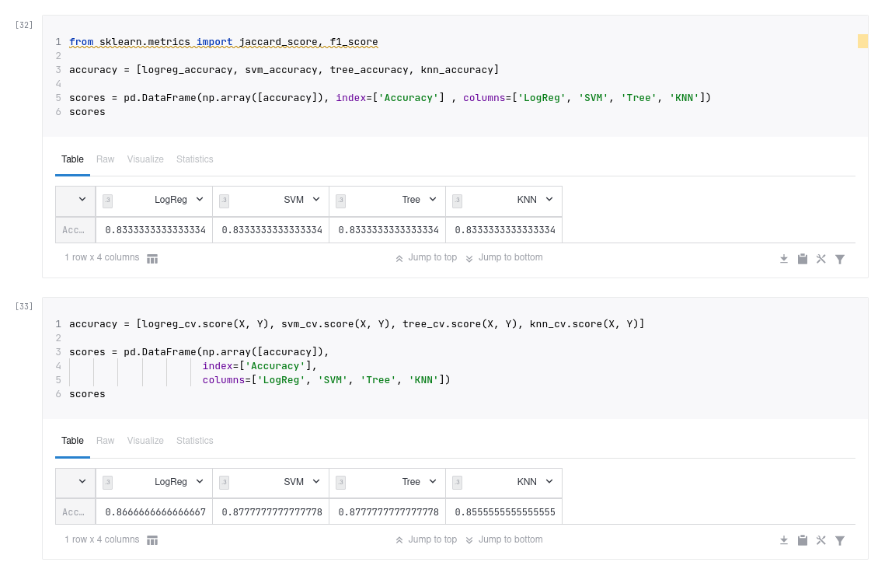
Classification Accuracy
The test sample is very small
The most appropriate model is the Decision Tree

Slide 44
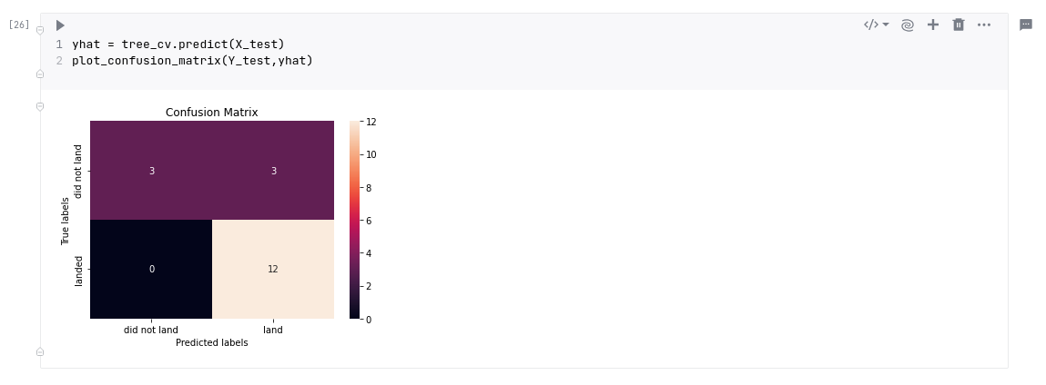
Confusion Matrix

Slide 45
Conclusions
Decision Tree Model is the top choice for predicting launch outcomes.
Low-payload launches tend to perform better than those with heavier payloads. Most launch sites are located near the Equator and along the coast. Launch success rates have been increasing over the years. Kennedy Space Center LC-39A has the highest success rate among all launch sites. Orbits ES-L1, GEO, HEO, and SSO have achieved very good success rates.

Slide 46


